Slide 1
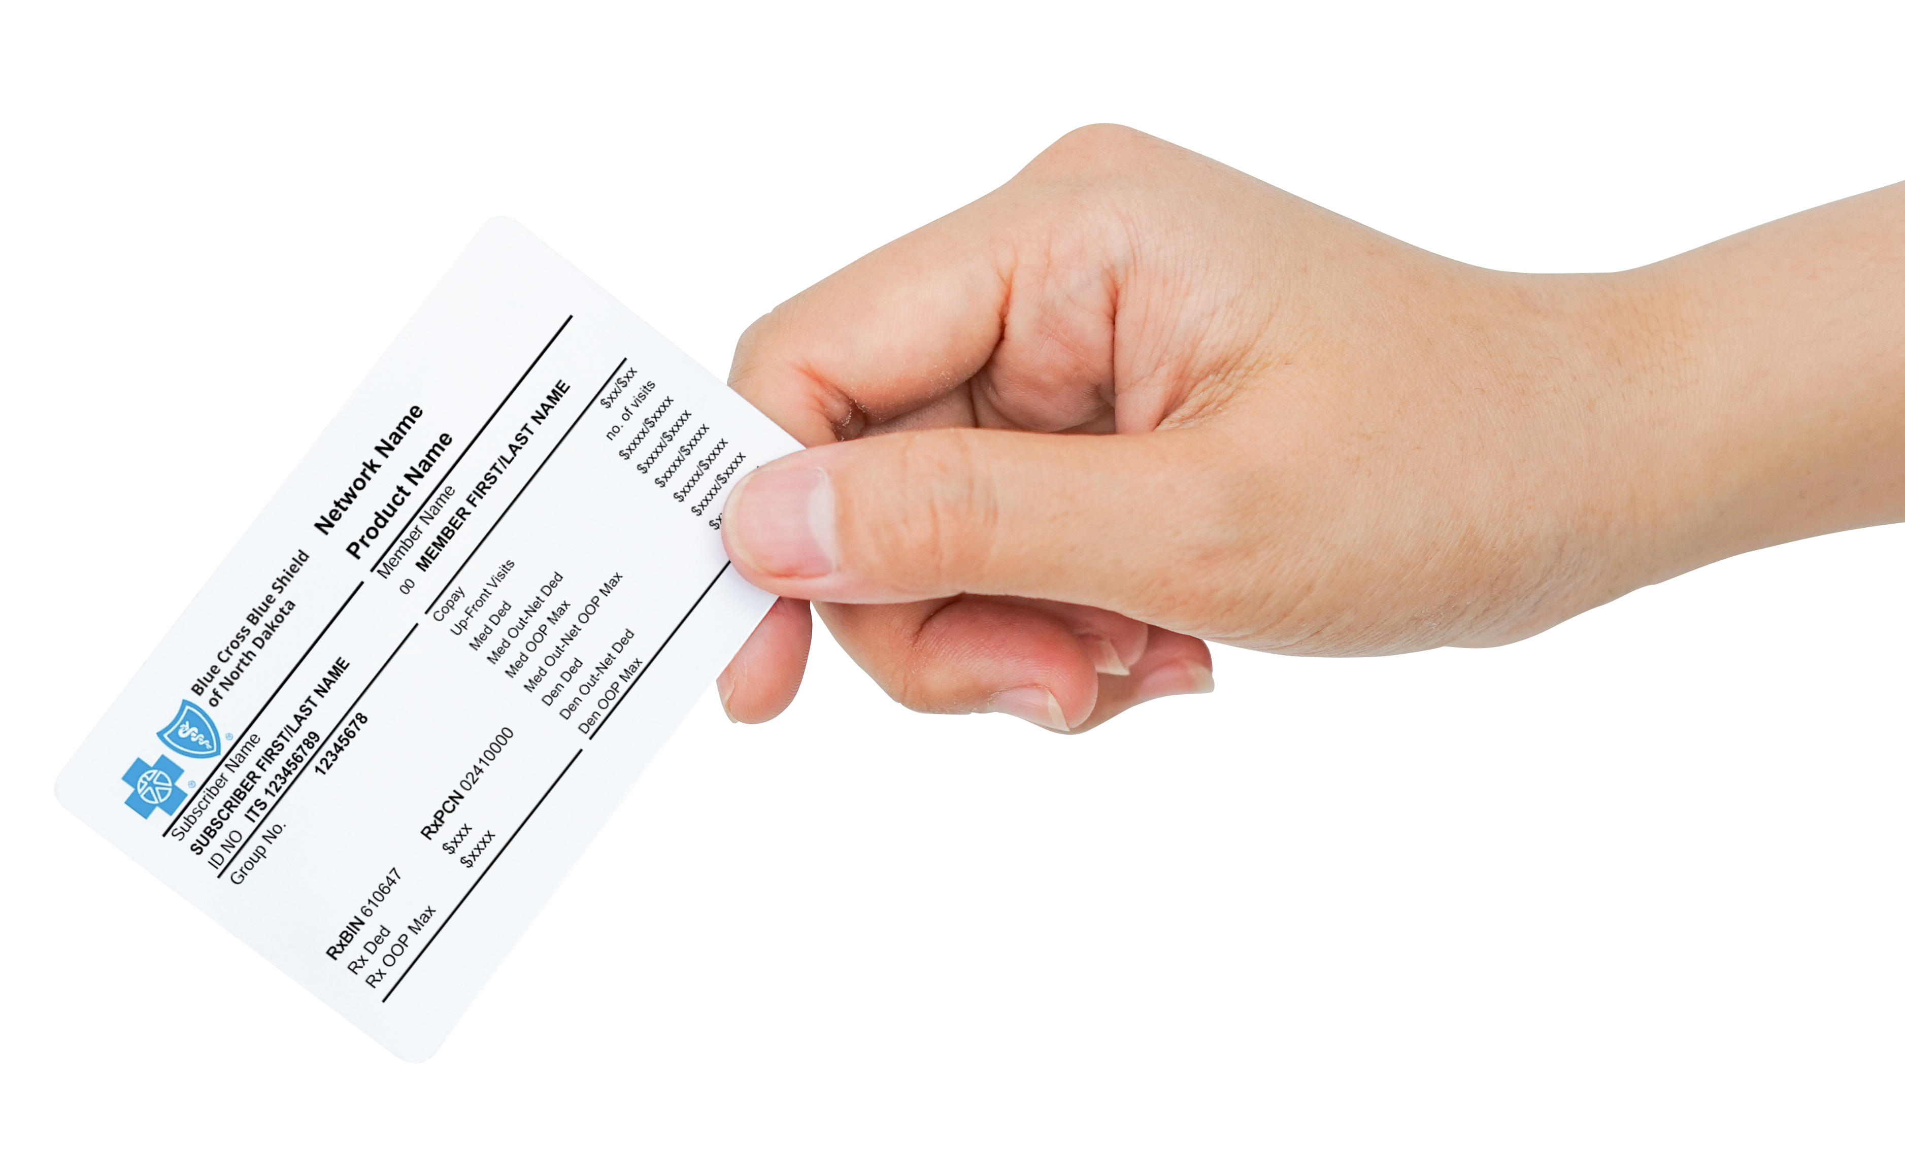

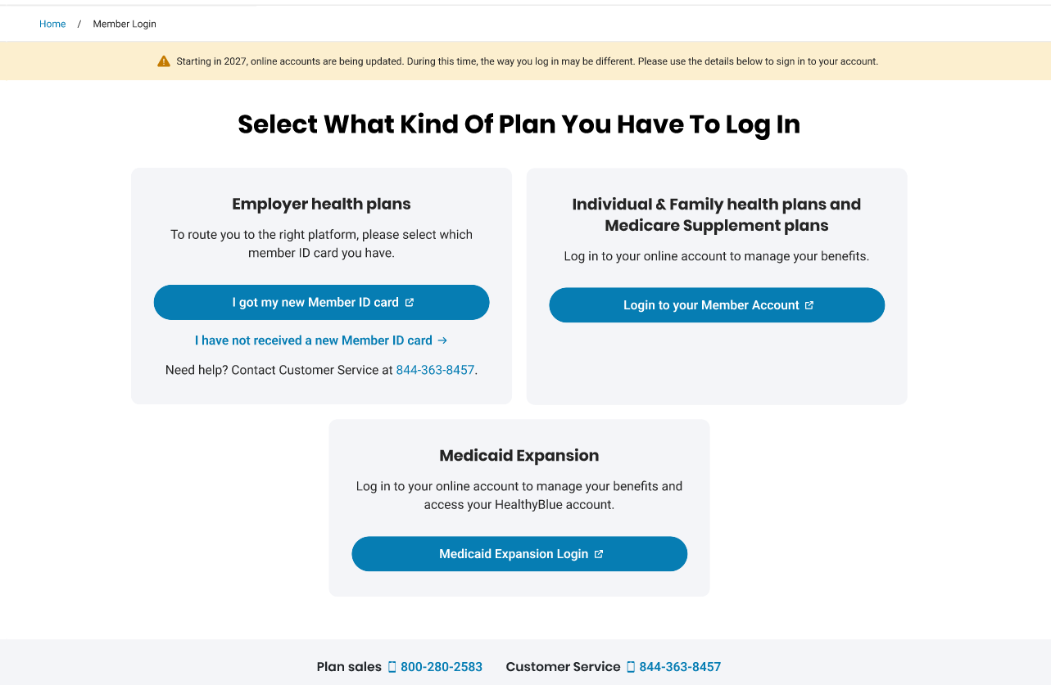
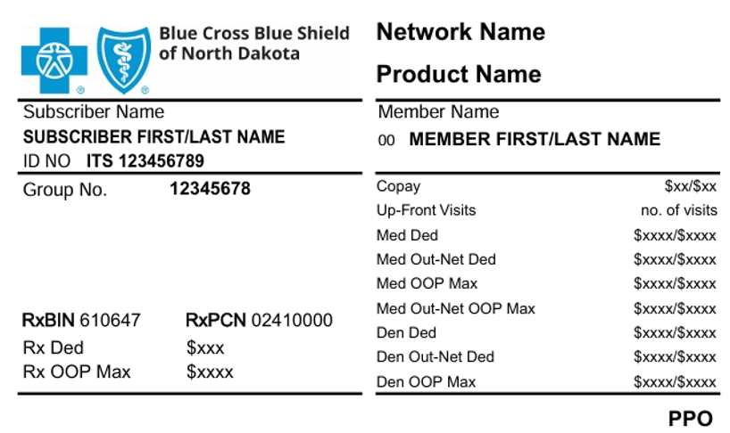
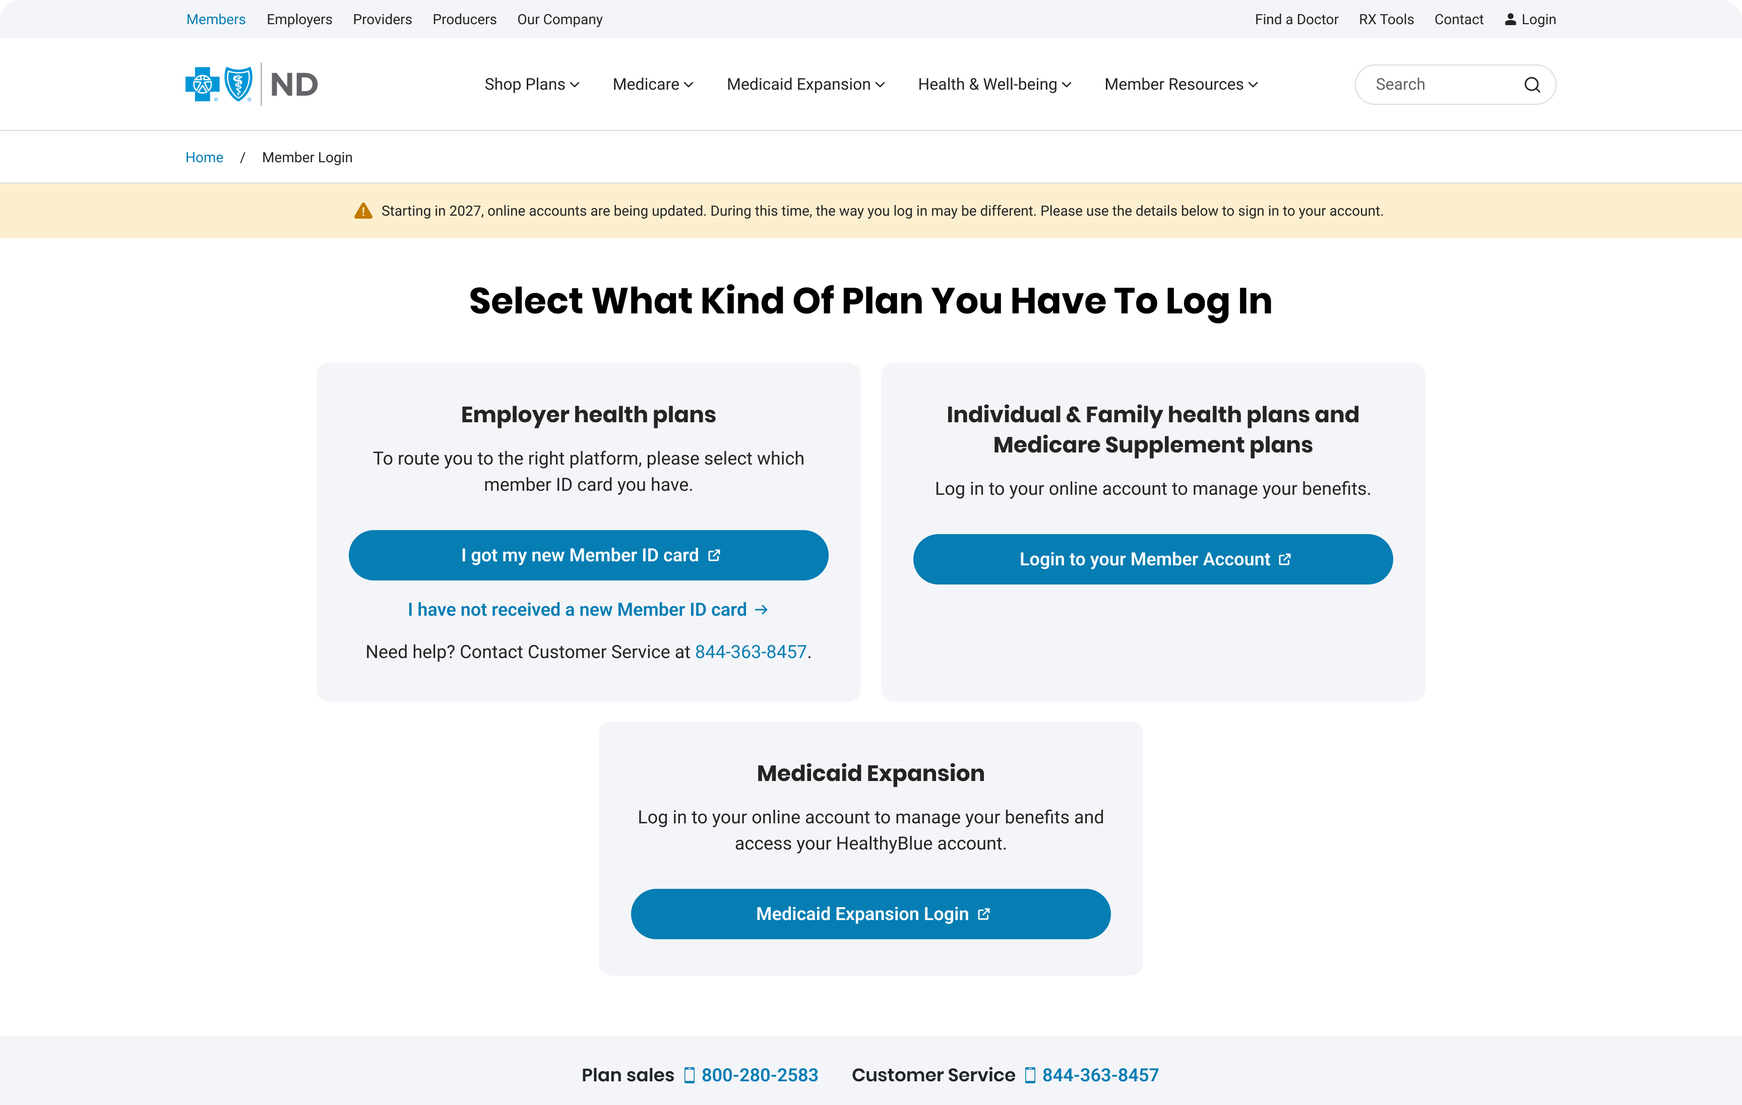
Get ready for your 2027 coverage
1
2
3
BEFORE COVERAGE BEGINS
GET A HEAD START
ONCE COVERAGE BEGINS
Watch for your
new ID card
Create your new
digital account
Start using
your coverage
Keep it handy for when
your 2027 coverage begins
Register early at BCBSND.com.
Your 2027 plan information will be
available once coverage begins.
Use your new ID card and
explore your plan’s resources.
GOOD TO KNOW: Your BCBSND.me access will end when your 2026 coverage ends.
Your new account will include three years of claims history.

