Slide 1

Notes:
Blue Cross Blue Shield of North Dakota is launching a new digital tool - BCSND.me - that will make it easier for those on our BCBSND health plan to manage their benefits and navigate care.

Slide 2
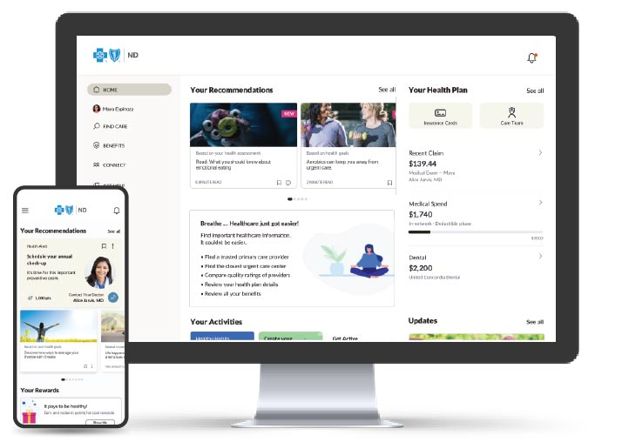
BCBSND.me Launching January 2025
Information and Access - View benefits, balances and claims in one place.
Engagement and Tracking - Get more out of wellness tools and programs.
Search and Ratings - Feel confident in finding the right provider.
Guidance and Support - Find support whenever and however it’s needed. Support is always available through chat or phone.

Slide 3
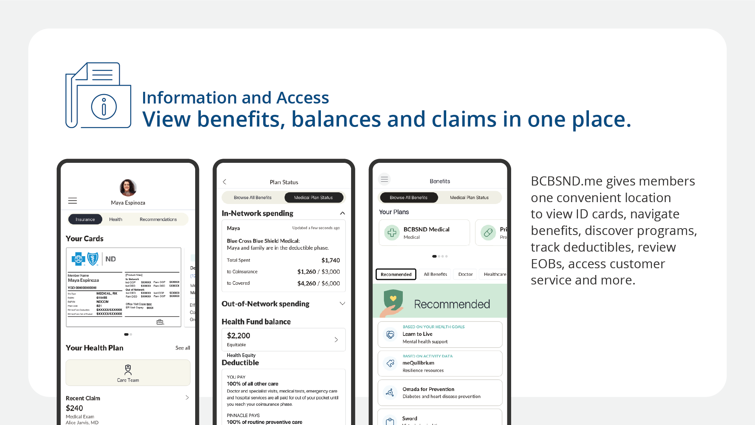

Slide 4
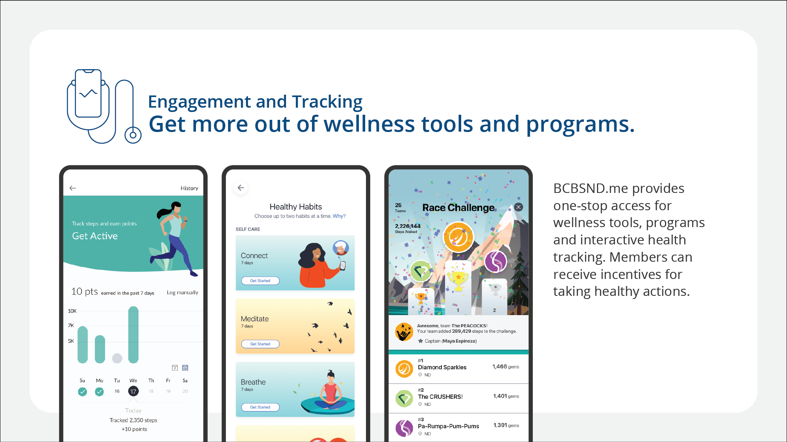

Slide 5
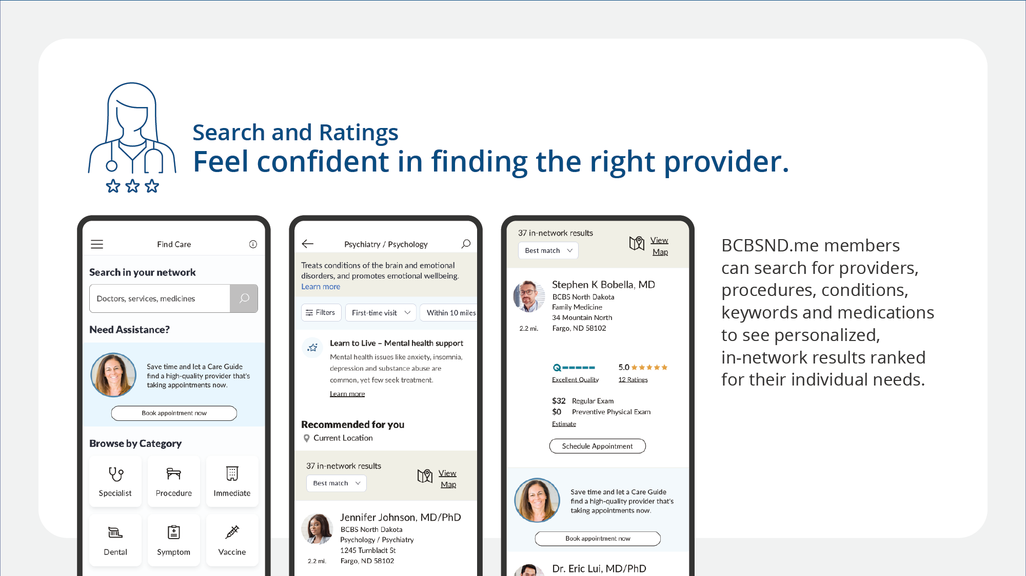

Slide 6
